Slide 1
Endocrine System

Slide 2
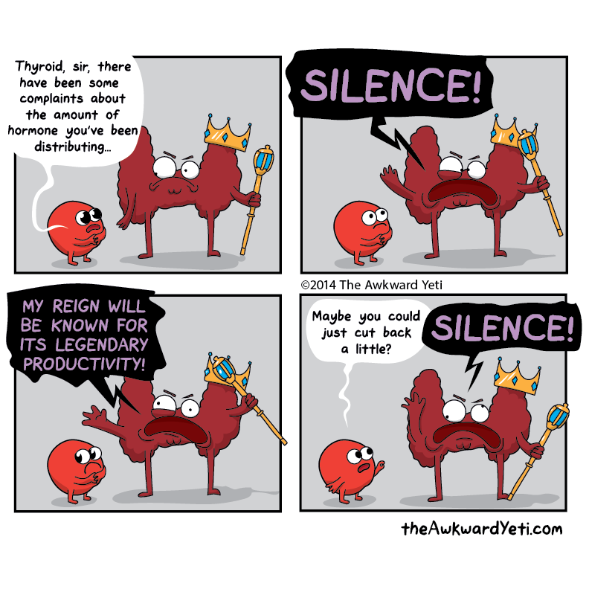

Slide 3
From the curriculum
many processes within the body are coordinated by hormones, which are secreted by glands and are transported to their target organs in the blood
hormone action can be via negative feedback to maintain internal conditions within tolerance limits; stimulus receptor, modulator, effector, response and feedback, are components of a feedback loop
the endocrine glands of the body include hypothalamus, pituitary, adrenal gland, pancreas, thyroid, pineal and parathyroid glands, testes, ovaries and placenta
thyroxine, cortisol, growth hormone and, to a lesser extent, adrenaline, all play a role in the regulation of metabolism

Slide 4
What is the Endocrine System?
The endocrine system is a system of organs that releases chemical messenger molecules, called hormones, into the blood.
Unlike the nervous system, whose actions help the body react immediately to change, the endocrine system controls changes that happen to the body over long periods of time, which can be minutes, hours, or even years.

Slide 5
Continued.
The two systems work closely together to help us respond to our environment.
The endocrine system is important in controlling metabolism, growth and development, reproduction, and salt, water, and nutrient balance in blood and other tissues (osmoregulation).

Slide 6
Continued.
The nervous system uses nerves to conduct electrical and chemical information around the body, while the endocrine system uses blood vessels to carry chemical information.
Coordination is achieved through the activities of the nervous and endocrine systems working together.

Slide 7
What does it do?
Much of the work of the endocrine system is concerning keeping the environment inside the body fairly constant (homeostasis).
Feedback is very important in regulating the secretion of hormones from endocrine glands. When the body responds to a change, or stimulus, by secreting more or less of a hormone, that response changes the original stimulus. This is known as feedback.

Slide 8
Endocrine glands
There are two endocrine gland in the human body:
- exocrine glands
- endocrine glands

Slide 9
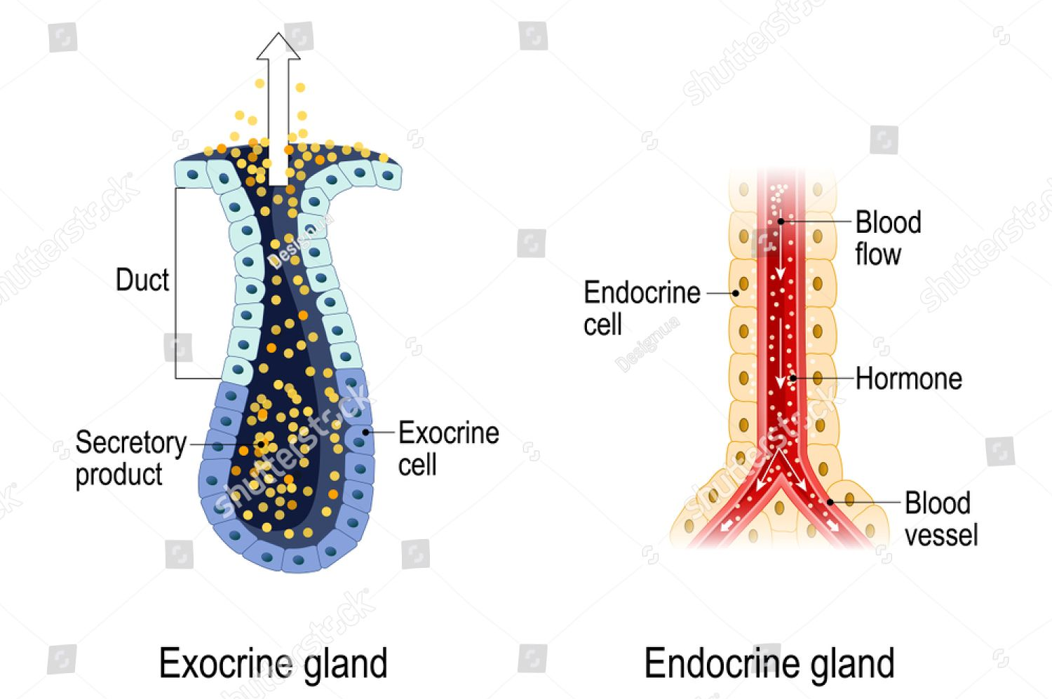

Slide 10
Exocrine glands
Exocrine glands secrete into a duct that carries the secretion to the body surface or to one of the body cavities.
Sweat glands, mucous glands, salivary glands and the glands of the alimentary canal (digestive system) are all examples of exocrine glands.

Slide 11
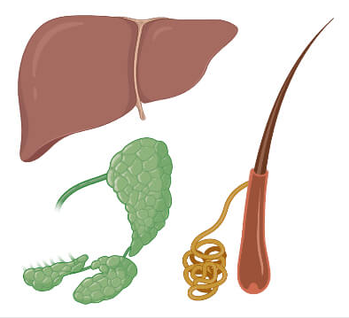
Organs of the Endocrine System- Exocrine glands

Slide 12
Endocrine glands
Endocrine glands secrete hormones into the extracellular (outside) fluid that surrounds the cells that make up the gland.
The secretion then usually passes into the capillaries to be transported by the blood.
Endocrine glands are sometimes called ductless glands.
E.g. hypothalamus, pineal gland, thyroid gland, parathyroid gland, pancreas, testes, ovaries, adrenal glands, and thymus.

Slide 13
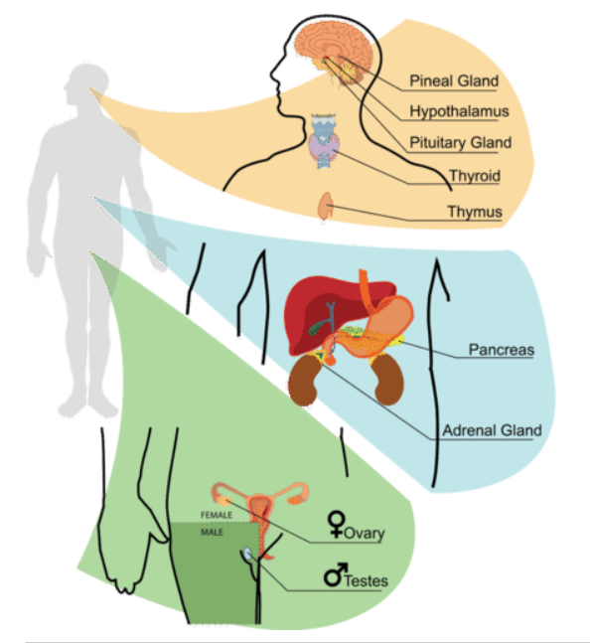
Organs of the Endocrine System- Endocrine glands

Slide 14
Hypothalamus and Pituitary Gland
The hypothalamus is located at the base of the brain
This organ regulates many of the basic functions of the body, such as body temperature, water balance and heart rate.
Many of the functions of the hypothalamus are carried out through the pituitary gland

Slide 15
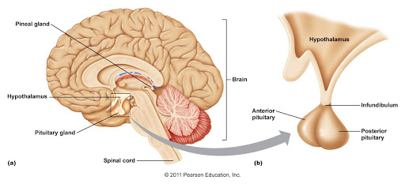
Continued
The pituitary gland lies just under the hypothalamus and is joined to the hypothalamus by a stalk called the infundibulum.

Slide 16
Continued.
The hypothalamus produces many different hormones.
Many pituitary hormones regulate the activity of other endocrine glands.
Sometimes the pituitary gland is referred to as the master gland.

Slide 17
Name of hormone released by pituitary gland | Location | Function
Gonadotropin | Gonads: ovaries/testes | Affect gonad production
Follicle-stimulating hormone | Ovary Testes | Stimulates egg development Stimulates production and maturation of sperm
Luteinising hormone | Ovary Testes | Brings about ovulation Secrete male sex hormones
Growth hormone | All cells | Growth and protein synthesis
Thyroid-stimulating hormone (TSH) | Thyroid gland | Secretion of hormones from the thyroid
Adrenocorticotropic hormone | Adrenal cortex | Secretion of hormones from adrenal cortex

Slide 18
Adrenal glands
There are two adrenal glands. One immediately above each kidney.
Each adrenal gland has an inner adrenal medulla and an outer adrenal cortex.
These two parts are quite different in their structure and function.

Slide 19
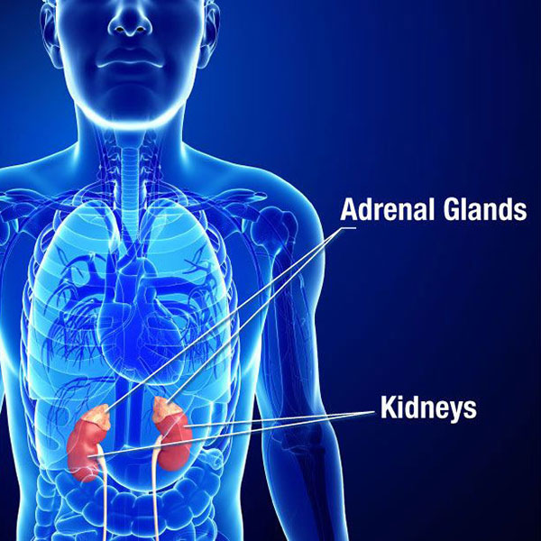

Slide 20
Continued.
Adrenal medulla:
- hormones produced by the adrenal medulla are adrenaline (helps to prepare the body for a reaction to threatening situations) and noradrenaline (increases the rate and force of the heartbeat).
Adrenal cortex:
- more than 20 different hormones are produced and are collectively known as corticosteroids.
- two main ones are aldosterone and cortisol.

Slide 21
Pancreas
Lies just below the stomach and alongside the duodenum
It is both an exocrine and endocrine gland
The exocrine part secretes digestive enzymes into the small intestine through the pancreatic duct.

Slide 22
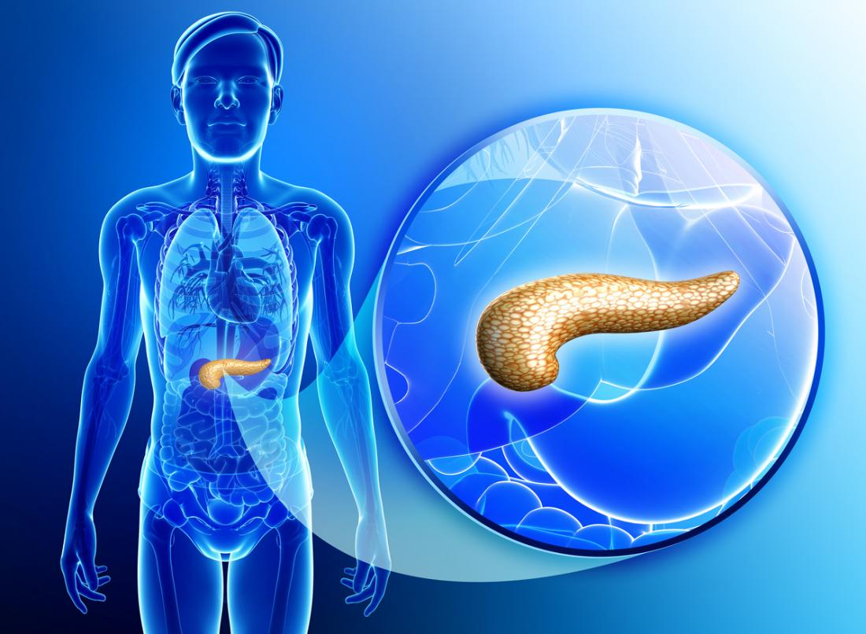

Slide 23
Pancreas
The exocrine part secretes two important hormones:
- insulin
- glucagon
The roles of insulin and glucagon is in maintaining a constant level of glucose in the blood.

Slide 24
Thyroid gland
Located in the neck
Secretes thyroxine, which controls body metabolism
Overall effect of thyroxine is to bring about the release of energy

Slide 25
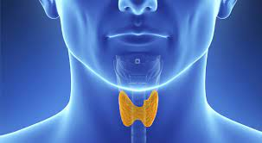

Slide 26
Pineal gland
Found inside the brain.
Secretes melatonin, which is involved in the regulation of sleep patterns.

Slide 27
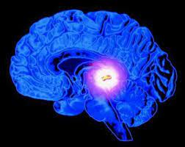

Slide 28
Parathyroid gland
Target the cells in bones and the kidneys
Increases level of calcium in the blood

Slide 29
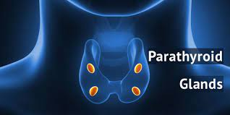

Slide 30
Placenta
Secretes a number of hormones during pregnancy that help to maintain the pregnancy, stimulate development of the foetus and stimulate the mother’s mammary glands

Slide 31
Hormones
The secretion of an endocrine gland is called a hormone.
Hormones may be proteins, steroid, or amines.
They are transported throughout the body in the blood.

Slide 32
Continued.
A hormone may affect all the cells of the body
OR
only particular groups of cells (target cells)
OR
particular organs (target organs)

Slide 33
Continued.
A hormone may affect all the cells in the same tissue by secreting chemicals that diffuse to adjacent cells.
These substances are called paracrines (local hormones).
Paracrines are secreted by all cells in a particular tissue and move through the extracellular fluid.

Slide 34
Continued.
Hormones, however, are secreted only by specialised cells and are transported by the bloodstream.
Hormones are only able to influence cells that have the correct receptor for the hormone.
That is, hormone receptors are specific.

Slide 35
Continued.
Saturation can also occur.
Once all the receptor molecules are occupied by hormone molecules, the addition of more hormones does not produce any greater effect.

Slide 36
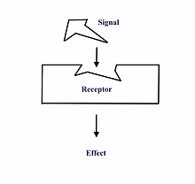

Slide 37
Continued.
Protein and amine hormones work by attaching to receptor proteins in the membrane of the target cell.
The combination of the hormone with the receptor causes a secondary messenger substance to diffuse through the cell and activate particular enzymes.

Slide 38
Continued.
For example, the hormone insulin binds to a receptor protein and this leads to an increase in glucose absorption by the cell.
Receptor proteins are specific.
Each type of receptor will bind with only one specific molecule (remember lock and key).

Slide 39
Continued.
There are also limited number of receptor proteins in the membrane of each cell, so when each receptor is bound to a molecule there can be no further increase in the rate of the cell’s activity.
For example, when each insulin receptor in the cell membrane is bound to insulin, the cell’s rate of glucose uptake cannot increase any further, even if the amount of insulin increases.

Slide 40
Continued.
Different cells have different types and numbers of receptor proteins.
This is why there is variation in the sensitivities of cells to hormones

Slide 41
Continued.
Steroid hormones work by entering target cells and combining with a receptor protein inside the cell.
The receptor may be on the mitochondria, on other organelles or in the nucleus.
The hormone-receptor complex activates the genes controlling the formation of particular proteins.

Slide 42
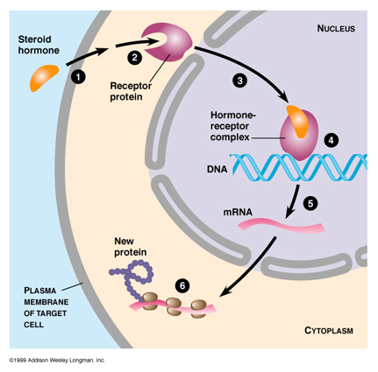

Slide 43
Continued.
Hormones change the functioning of cells by changing the type, activities or quantities of proteins produced.
They are not enzymes, but in many cases hormones exert their influence by changing the activity of enzymes or by changing the concentration of enzymes.

Slide 44
Continued.
Hormones may:
Activate certain genes in the nucleus so that a particular enzyme or structural protein is produced.
Change the shape or structure of an enzyme so that it is turned ‘on’ or ‘off’
Change the rate of production of an enzyme or structural protein by changing the rate of transcription or translation during protein production

Slide 45
Hormone secretions
Hormone secretions are generally regulated by negative feedback systems

Slide 46
Negative feedback

Slide 47
Stimulus: A change in environment occurs
Receptor: stimulus is detected by sensory cells
Message: sensory cells generate a message in the form of a nerve impulse or hormone
Modulator: a new message is sent out by the modulator
Effector: muscles or glands receive the message from the modulator
Response: effector organs bring about an appropriate reaction
Feedback: response changes the original stimulus

Slide 48
Negative Feedback Loops
In homeostatic mechanisms the response has the effect of reducing or eliminating the stimulus that caused it
E.g. Let’s suppose you feel cold. In response to the stimulus of feeling cold you put on a jumper and no longer feel cold. Your response has reduced or eliminated the original stimulus of feeling cold.

Slide 49
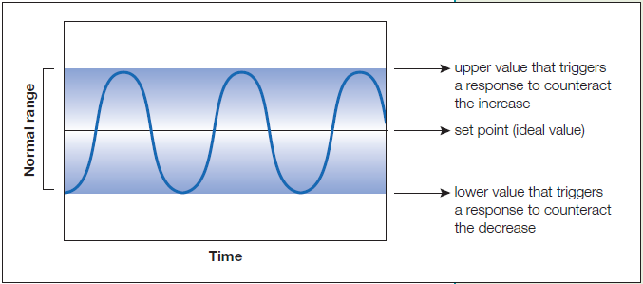

Slide 50
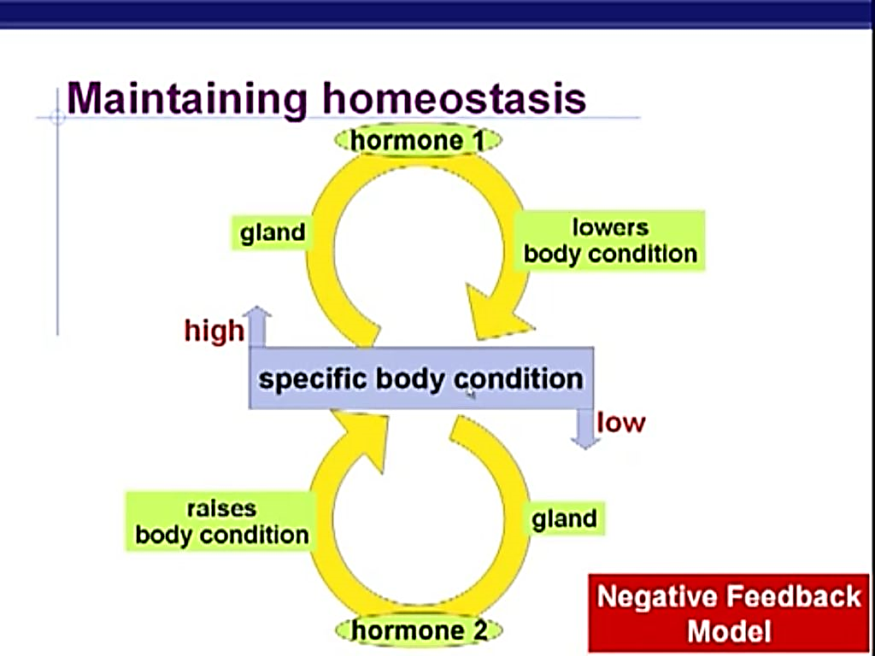

Slide 51
Review Questions
How are the endocrine and nervous systems similar?
How are the endocrine and nervous systems different?
What are hormones? Use an example in your response.
What are the organs of the endocrine system?

